Slide 1
Industry and Firm Analysis

Slide 2
Competitive
Landscape

Slide 3
Competitors
Direct
Competitors
Indirect
Competitors
Future
Competitors
Travel Agency
Online Booking
Global Tour
Companies
Online Tour
Providing Service
Travel Blog
Information
Guide Apps

Slide 4
Competitor Analysis
 |  | Convenience | Customizable | Providing Information | Availability of Transports | Domestic/ Foreign | Domestic Coverage | Experience | Recognition
TourDibo |  | Even | Advantage | Advantage | High | Domestic | High | Disadvantage | Disadvantage
Direct | Travel Agency | Even | Disadvantage | Disadvantage | High | Domestic/ Foreign | High | Advantage | Advantage
 | Online Tour Providing Service | Even | Disadvantage | Disadvantage | Low | Domestic/ Foreign | Low | Advantage | Disadvantage
Indirect | Online Booking | Even | Disadvantage | Disadvantage | Low | Domestic & Foreign | Low | Advantage | Advantage
 | Travel Blog | Disadvantage | Disadvantage | Advantage | - | Domestic & Foreign | High | Advantage | Advantage
Overall: Moderate
Customizable Offers at Fair Prices even though a bit behind in Recognition and Networking
Source: Ahmad, S. (2017, March 26). Tourism Industry in Bangladesh. Retrieved from The Daily Star

Slide 5
Competitor Analysis – Specified
Direct Competitors (50+)
Competitors | Transportation Booking | Hotel Booking | Information Providing | Domestic Coverage | Customization | Packaged Tour | Score | Competitive Advantage
ShareTrip | Flight Only | Applicable | N/A | Limited | N/A | Applicable | 40/60 | Moderate
Travel Guru Bangladesh | Cars/Microbuses | Applicable | Less | Limited (4 Places) | Absent | Applicable | 38/60 | Moderate
Ticketshala.com | Flight/Cars | Applicable | Absent | Limited | N/A | Limited | 38/60 | Moderate
Tour.com.bd | All Applicable | Applicable | Absent | Limited | Absent | Applicable | 36/60 | Moderately Weak
Travel Agencies | N/A | N/A | N/A | Broad | N/A | Applicable | 28/60 | Weak

Slide 6
Point of Differentiation
Convenience
Customizable
Information
Asymmetry

Slide 7
Economical Trend (PESTEL) Analysis
P
Political
E
Economic
S
Social
T
Technological
E
Environmental
L
Legal
Moving Towards Stability
BDT 650 Million yearly being distributed to Tourism board for further improvement of Tourism Industry
BDT 427.5 Billion; almost 2.2% of total GDP in 2017
Will rise by 6.1% over the years (Source: WTTC)
Directly supported 1,178,500 jobs amounting to 1.8% of total employment
Target Demographic: Youth (as influencers)
Increased per capita income $1888 (2019) encourages taking vacations.
Increasing number of tourists YoY.
80.89 Million internet users currently (Source: BRTC)
80.47 Million Mobile & 570,000 Broadband users
87% of total users are of between the age of 18 to 25 (Source: GSMA Intelligence)
Awareness needed against Littering of Tourist Spots
Risk of Injury in cases of not taking precautions during hiking and trekking.
Regulated by: Bangladesh Tourism Act 2013
National Tourism Policy 2010
Source: Ahmad, S. (2017, March 26). Tourism Industry in Bangladesh. Retrieved from The Daily Star

Slide 8
Demand & Supply Drivers
Demand Drivers
Supply Drivers
Population
Positive Relation Between Size of Population and
Tourism
Accommodation Facility
Increasing number and quality of hotels, resorts and facilities for the new surge of tourists
Income
Increased Per Capita Income (2019: $1888)
Infrastructure Development
Construction of roads and betterment of overall
Infrastructure contributes to the cause
Spending Pattern
Travelling spending increased over the years.
[ Middle and Upper Middle Class: BDT 15000 – 20000
Upper Class: BDT 80000+]
Communication and Security
Good communication with better security for the tourists added to the industry
Trend & Stability
New trend of travelling with the stable political and natural environment
Source: Rahman , S., & Chakma, J. (2018, December 14). Tourism Booming with Economy. Retrieved from The Daily Star

Slide 9
Product Feasibility
Variable | Value | Rating | Score (Out of 10)
Advantage of Trend | Advantageous | Favorable | 8
Unfilled Gap of Market | Increasing Opportunity | Somewhat Favorable | 7
Solving a Problem | Good to Have | Somewhat Favorable | 6
Timeliness of Entry | Early | Favorable | 8
Value Addition | Added Value | Somewhat Favorable | 6
Customer Satisfaction | Retention | Somewhat Unfavorable | 6
Customer Behavior Change | Pattern | Somewhat Unfavorable | 5
Somewhat
Favorable
46/70
Source: Favorability Scale. (2019, September 1). Retrieved from Monash University Official Website

Slide 10
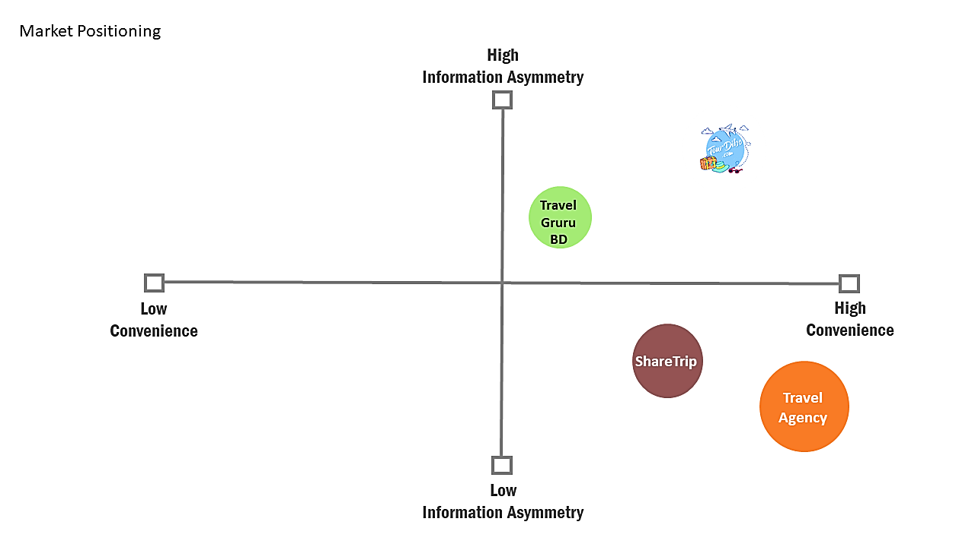
Positioning Map
Moderately
Advantageous

Slide 11
Industry
Analysis

Slide 12
Five Forces Model
Threat of New Entrants (HIGH)
Profitability Range
MODERATE
Chance of Entrance of Small Enterprise (HIGH)
Chance of Entrance of MNCs (HIGH)
Time Required: 4-6 Months
Power of Supply (MED)
Competitive Rivalry (LOW)
Power of Buyer (HIGH)
Bargaining Power of Suppliers (LOW)
Number of Suppliers (HIGH)
Switching Cost (HIGH)
OTAs: 50+
Online Presence: 4-6% (LOW)
Availability of Information (HIGH)
Switching Cost (LOW)
Threat of Substitutes (LOW)
Chance of Replace on Demand (LOW)
Availability of Substitutes (LOW)
Source: Future Startup. (2019, February 5). The Future Of Online Travel Agency (OTA) In Bangladesh. Retrieved from Future Startup

Slide 13
Industry Feasibility
Variable | Value | Specified | Rating | Score (Out of 10)
Size | Large | 5,000 Crore | Favorable | 8
Growth | High | 16.67% (Historical) | Favorable | 7
Industry Age | Young |  | Somewhat Favorable | 6
Major Players | Fragmented | 500+ Companies and 25000 Agents | Somewhat Unfavorable | 5
Profitability | Moderate | 14.91% | Somewhat Favorable | 6
Major Regulations | Regulated | Bangladesh Travel Agencies Act 2013 and Tourist Resort Act 2010. | Somewhat Favorable | 6
Demand | Want to Have |  | Favorable | 8
Operating Margin | Low | less than 27% | Unfavorable | 4
Porter’s Five Forces | Moderate | - | Somewhat Favorable | 6
Somewhat
Favorable
56/90
Source: Favorability Scale. (2019, September 1). Retrieved from Monash University Official Website

Slide 14
Marketing
Plan

Slide 15
Targeting - Buyer Persona
 | Profile 1 | Profile 2 | Profile 3
 | YounDult | Millennial | Gen X
Age | 18 - 25 | 25 - 30 | 35+
Profession | Students | Job Holder (Entry) | Job Holder (High)
Income | Low (10k-20k) | Medium (40k - 100k) | High (100k+)
Preference | Adventurous | Adventurous /Relaxing | Relaxing
Spending Pattern | Low to Medium | Medium to High | High
Media | BTL: Social Media (Facebook, Instagram) | Essentially Below the Line. At the same time Above the Line | ATL: TV Campaigns

Slide 16
Positioning & Differentiation
Convenience
Customizable
Information
Asymmetry
Your One-Stop-Solution to Every Journey
Initially: Single Tier Pricing
Long Term: Variable Rate Pricing
Initially: More for the Same
Long Term: More for More

Slide 17
IMC - Message
Objective
0.80% of Existing Market Gap in Year 1
Appeal Rationally

Slide 18
IMC – Media (ATL)
Print Ad
Billboards
& Posters
Personal
Communication
Channel

Slide 19
IMC – Media (BTL)
Social Media
E-mail
Promotion
YouTube
Ads
SEO & SEM
Loyalty
Programs

Slide 20

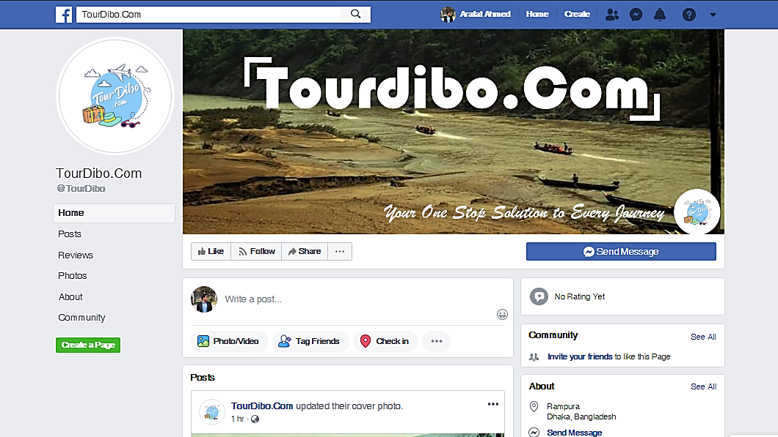

Slide 21


Slide 22
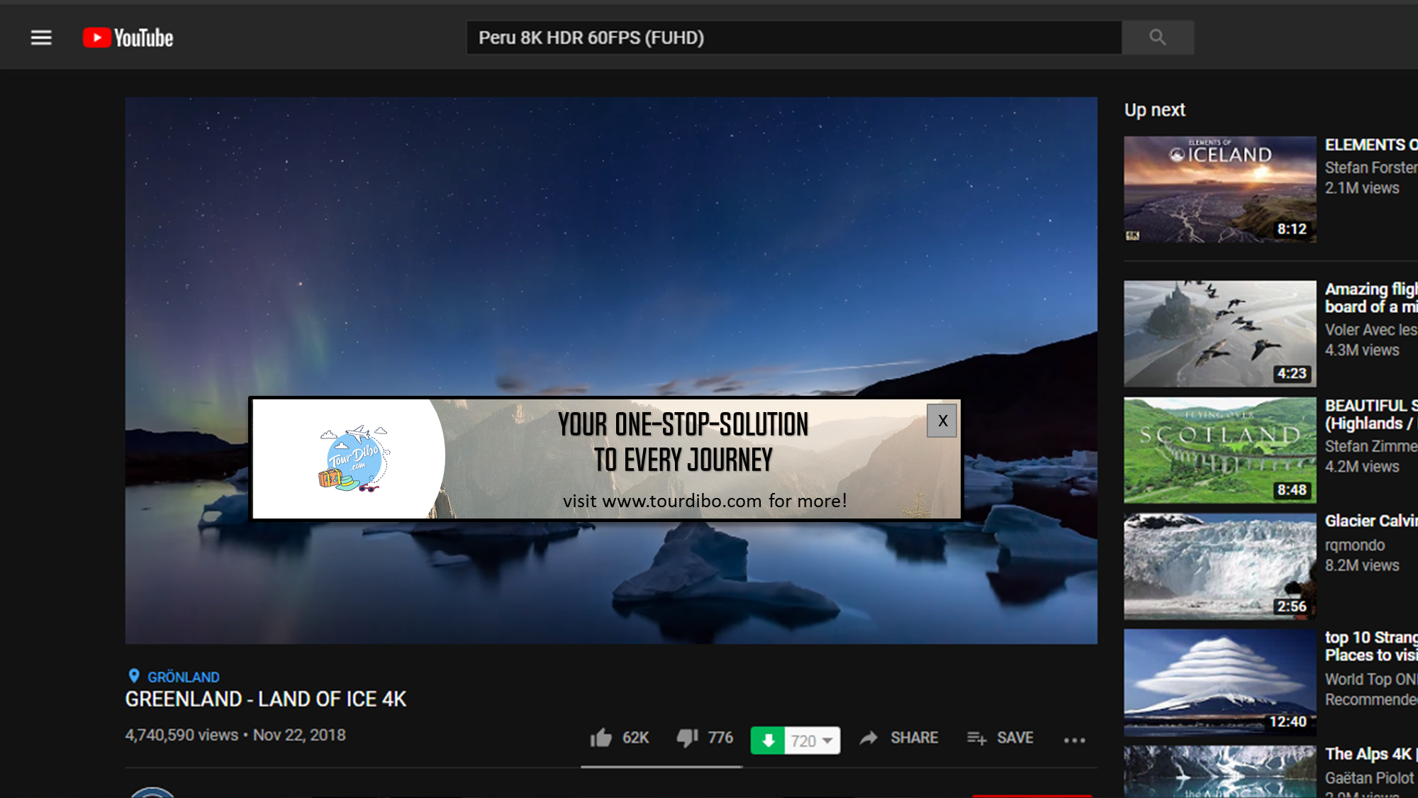

Slide 23
IMC – Budget
 | Q1 | Q2 | Q3 | Q4 | Yearly
Advertisements | 766,500 | 547,500 | 328,500 | 547,500 | 2,190,000
Discounts And Promotions | 70,000 | 50,000 | 30,000 | 50,000 | 200,000
Digital Billboards | 157,500 | 112,500 | 67,500 | 112,500 | 450,000
Print Media | 70,000 | 50,000 | 30,000 | 50,000 | 200,000
Loyalty Program: Customers | 17,500 | 12,500 | 7,500 | 12,500 | 50,000
Loyalty Program
Gold | 70,000 | 50,000 | 30,000 | 50,000 | 200,000
Silver | 52,500 | 37,500 | 22,500 | 37,500 | 150,000
Bronze | 52,500 | 37,500 | 22,500 | 37,500 | 150,000
Referral Bonuses | 175,000 | 125,000 | 75,000 | 125,000 | 500,000
Virtual Gift Cards/ Vouchers | 87,500 | 62,500 | 37,500 | 62,500 | 250,000
*BDT

Slide 24
Marketing Roadmap
January | February | March | April | May | June | July | August | September | October | November | December
Print Ads
Billboards
Social Media
 |  |  |  |  |  |  |  |  | E-mail Promotion
 |  |  | Personal Communication |  |  |  |  |  | Personal Communication
 |  | Youtube Ads
 |  |  | Mass Media
 |  |  | SEO and SMO
 |  |  | Travel Blogs
First Year

Slide 25
Management Positions
HR | Finance & Accounting | Legal
CHRO | CFO | Consultant Lawyer
HR Administrator | Chief Accountant
Operations | IT | Marketing
COO | CTO | CMO
Administration (Full time) | Full time Designer, Web Developer | Customer Relationship (Full time)
Site Representative (Part time) | Full time App Developer | Marketing Consultant
Operation Coordinator | Part Time Designer, Web Developer | Marketing Research Analyst
 | Part time Content Designer

Slide 26
Employee Requirements
 | Year 1 | Year 2 | Year 3 | Year 4
Expected Number of Customer Served | 23,252 | 44,888 | 72,194 | 105,049
Expected Highest Number of Customer Served Daily | 90 | 175 | 281 | 409
Number of Employees | 32 | 40 | 49 | 57
Salary Paid | 8,220,000 | 11,140,800 | 14,528,160 | 19,275,000

Slide 27
Operational
Roll Out

Slide 28
Office Space
5 – Room - Compartment
Reasonable Rent
House # 28, Road # 2
Block C, Banasree,
Rampura, Dhaka
Good Communication System
Easy to Commute
Rent: BDT 26000 Monthly
Business-Friendly Environment
1400 Square Feet

Slide 29
Value Chain
Core Activities | Inbound Logistics | Operations | Outbound Logistics | Marketing and Sales | After Sales Services
Support Activities | Infrastructure
 | HRM
 | Technology Development
 | Resource Procurement
Hotels (100 for Pilot Run)
Transport Companies, Railways.
Local Car and Boat Rentals
Information Provision
Bookings
Transportation Facilities
Cash Payment
Mobile Financial Services
E- Wallet
Courier
Google AdSense
SEO
Search Engine Marketing
Facebook Page
Offers and Discounts
Hotel Reviews & Ratings
Feedback Reception
Action against Complaints
Loyalty Points
One Physical Office
Legal Framework
IT Team
Agile Workforce & Interns
Website Based Bookings
ChatBots and Data Analytics
Bangladesh Parjatan Corporation
Bangladesh Tourism Board

Slide 30
Start-Up Capital
Requirement

Slide 31
Fund Raising
The Timeline
 | Month 0 | Month 1 | Month 2 | Month 3 | Month 4 | Month 5 | Month 6 | Month 7 | Month 8 | Month 9 | Month 10 | Month 11 | Month 12
RR&D | Recruiting Cost | Data Collection |  | Content Development |  |  |  |  |  |  |  |  | Product Launch
 | 5,000 | 491,250 |  | 40,000
Website & App Development | Recruiting Cost | Structure Development |  |  |  | Data Input
 | 12,000 | 630,000 |  |  |  | 32,000
Operation | Workplace Equipment |  |  |  |  |  |  | App Distribution |  | Test Run |  | Initial Marketing
 | 670,000 |  |  |  |  |  |  | 238,000 |  | 135,000 |  | 206,500
 | Workspace Rent, Electricity Bill, Internet Service and Salary of Accountant
 | 576,000
Legal | Lawyer | Necessary Registration |  |  | Consulting Lawyer
 | 20,000 | 96,635 |  |  | 48,000
*BDT

Slide 32
Initial Capital Expenditure (CapEx)
Items | Amount
RD&D | 536,250
Website & APP Development | 884,000
Workplace Equipment | 481,600
Legal Expenditure | 96,635
APP Disbursement | 238,000
Total | 2,236,485
*BDT

Slide 33
Net Working Capital
Items | Amount
Test Run | 135,000
Workspace Rent | 280,000
Electricity Bill | 72,000
Internet | 24,000
Salary of Accountant | 240,000
Marketing Expense | 206,500
Consulting Lawyer | 68,000
Total | 1,025,500
*BDT

Slide 34
FFnFs
 | Profile 1 | Profile 2 | Profile 3 | Profile 4
Name | MD. Nayeem Ahmed | Naznin Hossain | Syed Mostaque Hossain | Marufa Akter
Occupation | Businessmen | Housewife | Service Holder | Banker
Relation with the Co-founder | Father | Mother | Father | Sister
Investment Amount | 4 Lakhs | 5 lakhs | 5 lakhs | 1 Lakh
Investment type (Debt or Equity) | Debt | Equity | Equity | Equity
Conditions (Any) | - | - | - | -
Incentives
Interest | Variable Interest Rate (Inflation + 2%) | - | - | -
Stock | - | 3% | 4% | 2%
BOD | - | - | 1 Seat | -
BOA | - | - | - | -

Slide 35
Financial
Plan

Slide 36
Revenue Stream
 | 2021-22 | 2022-23 | 2023-24 | 2024-25
Market Size ( Domestic) | 50,000,000,000 | 58,335,000,000 | 68,059,444,500 | 79,404,953,898
Average growth rate | 16.67% | 16.67% | 16.67% | 16.67%
Number of Tourists | 8,000,000 | 8,847,014 | 9,783,708 | 10,819,575
Average Spending of tourists ( Yearly) | 6,250 | 6,594 | 6,956 | 7,339
Inflation Rate ( Estimated) | 5.50% | 5.50% | 5.50% | 5.50%
Number of Hotels ( Estimated) | 320 | 440 | 520 | 520
Access to Internet | 87% | 90% | 93% | 93%
Tourists Able to Use Our Service | 6,960,000 | 7,962,313 | 9,098,848 | 10,062,205
% Tourists Who May Be interested ( Searching for more Flexibility) | 58% | 58% | 58% | 58%
Tourists Who May Be interested | 4,036,800 | 4,618,141 | 5,277,332 | 5,836,079
Target Market (Aged 15-45) | 72% | 72% | 72% | 72%
Target market (Number of Tourists) | 2,906,496 | 3,325,062 | 3,799,679 | 4,201,977
Market Penetration ( % of Target Market) | 0.80% | 1.35% | 1.90% | 2.50%
Market Penetration (Tourists) | 23,252 | 44,888 | 72,194 | 105,049
Market Penetration (Taka) | 145,324,800 | 295,982,456 | 502,210,096 | 770,958,578
Commission | 5.00% | 5.00% | 4.50% | 4.00%
Commission from the User | 7,266,240 | 14,799,123 | 22,599,454 | 30,838,343
Average Cost of Hotel | 1,000 | 1,055 | 1,113 | 1,174
Average Tourist per Room | 3 | 3 | 3 | 3
Room Booked ( Yearly) | 7,751 | 14,963 | 24,065 | 35,016
Average Room Booked in Taka | 7,750,656 | 15,785,731 | 26,784,538 | 41,117,791
Commission from Hotel | 387,533 | 789,287 | 1,339,227 | 2,055,890
Average Revenue Per Person | 329 | 347 | 332 | 313
*BDT

Slide 37
Income Statement – Year 1
February 2021-January 2022
 | Q1 | Q2 | Q3 | Q4 | 2021-22
Commission Income from Users | 1,089,936 | 2,179,872 | 1,453,248 | 2,543,184 | 7,266,240
Commission Income from Hotel | 58,130 | 116,260 | 77,507 | 135,636 | 387,533
Net Commission income | 1,148,066 | 2,296,132 | 1,530,755 | 2,678,820 | 7,653,773
Total expenses
Salaries and Allowances | 2,055,000 | 2,055,000 | 2,055,000 | 2,055,000 | 8,220,000
Rent, Electricity etc. | 102,000 | 102,000 | 102,000 | 102,000 | 408,000
Website Maintenance Cost | 136,500 | 136,500 | 136,500 | 136,500 | 546,000
App Maintenance Cost | 127,000 | 127,000 | 127,000 | 127,000 | 508,000
Postage | 52,317 | 104,634 | 69,756 | 122,073 | 348,780
Stationery and printing | 27,902 | 55,805 | 37,203 | 65,106 | 186,016
Advertisements | 766,500 | 547,500 | 328,500 | 547,500 | 2,190,000
Depreciation | 45,740 | 45,740 | 45,740 | 45,740 | 182,960
Interest Expense | 30,000 | 30,000 | 30,000 | 30,000 | 120,000
Total expenses | 3,312,959 | 3,174,179 | 2,901,699 | 3,200,918 | 12,589,755
Total profit before tax | -2,164,893 | -878,047 | -1,370,944 | -522,098 | -4,935,982
Income tax | 0 | 0 | 0 | 0 | 0
Net profit after tax | -2,164,893 | -878,047 | -1,370,944 | -522,098 | -4,935,982
*BDT

Slide 38
Income Statement – Year 2
February 2022-January 2023
 | Q1 | Q2 | Q3 | Q4 | 2022-23
Commission Income from Users | 2,219,868 | 4,439,737 | 2,959,825 | 5,179,693 | 14,799,123
Commission Income from Hotel | 118,393 | 236,786 | 157,857 | 276,250 | 789,287
Net Commission income | 2,338,261 | 4,676,523 | 3,117,682 | 5,455,943 | 15,588,409
Total operating expenses
Salaries and Allowances | 2,785,200 | 2,785,200 | 2,785,200 | 2,785,200 | 11,140,800
Rent, Electricity etc. | 153,000 | 153,000 | 153,000 | 153,000 | 612,000
Website Maintenance Cost | 204,750 | 204,750 | 204,750 | 204,750 | 819,000
App Maintenance Cost | 190,500 | 190,500 | 190,500 | 190,500 | 762,000
Postage | 100,999 | 201,998 | 1,346,650 | 235,664 | 673,325
Stationery and printing | 53,866 | 107,732 | 71,821 | 125,687 | 359,107
Advertisements | 657,000 | 657,000 | 657,000 | 657,000 | 2,628,000
Depreciation | 53,684 | 53,684 | 53,684 | 53,684 | 214,736
Interest Expense | 30,000 | 30,000 | 48,750 | 48,750 | 157,500
Total operating expenses | 4,198,999 | 4,353,864 | 5,462,605 | 4,405,485 | 17,208,968
Total profit before tax | -1,860,737 | 322,659 | -2,344,923 | 1,050,458 | -1,620,558
Income tax | 0 | 0 | 0 | 0 | 0
Net profit after tax | -1,860,737 | 322,659 | -2,344,923 | 1,050,458 | -1,620,558
*BDT

Slide 39
Income Statement – Year 3
February 2023-January 2024
 | Q1 | Q2 | Q3 | Q4 | 2023-24
Commission Income from Users | 3,389,918 | 6,779,836 | 4,519,891 | 7,909,809 | 22,599,454
Commission Income from Hotel | 200,884 | 401,768 | 267,845 | 468,729 | 1,339,227
Net Commission income | 3,590,802 | 7,181,604 | 4,787,736 | 8,378,538 | 23,938,681
Total operating expenses
Salaries and Allowances | 3,632,040 | 3,632,040 | 3,632,040 | 3,632,040 | 14,528,160
Rent, Electricity etc. | 229,500 | 229,500 | 229,500 | 229,500 | 918,000
Website Maintenance Cost | 307,125 | 307,125 | 307,125 | 307,125 | 1,228,500
App Maintenance Cost | 285,750 | 285,750 | 285,750 | 285,750 | 1,143,000
Postage | 162,436 | 324,873 | 216,582 | 379,018 | 1,082,908
Stationery and printing | 86,633 | 173,265 | 115,510 | 202,143 | 577,551
Advertisements | 788,400 | 788,400 | 788,400 | 788,400 | 3,153,600
Depreciation | 64,421 | 64,421 | 64,421 | 64,421 | 257,683
Interest Expense | 48,750 | 48,750 | 48,750 | 48,750 | 195,000
Total operating expenses | 5,556,305 | 5,805,374 | 5,639,328 | 5,888,397 | 22,889,403
Total profit before tax | -1,965,503 | 1,376,231 | -851,591 | 2,490,142 | 1,049,278
Income tax | 0 | 481,681 | -298,057 | 871,550 | 367,247
Net profit after tax | -1,965,503 | 894,550 | -553,534 | 1,618,592 | 682,031
*BDT

Slide 40
Income Statement – Year 4
February 2024-January 2025
 | Q1 | Q2 | Q3 | Q4 | 2024-25
Commission Income from Users | 4,625,751 | 9,251,503 | 6,167,669 | 10,793,420 | 30,838,343
Commission Income from Hotel | 308,383 | 616,767 | 411,178 | 719,561 | 2,055,890
Net Commission income | 4,934,135 | 9,868,270 | 6,578,847 | 11,512,981 | 32,894,233
Total operating expenses
Salaries and Allowances | 4,818,750 | 4,818,750 | 4,818,750 | 4,818,750 | 19,275,000
Rent, Electricity etc. | 344,250 | 344,250 | 344,250 | 344,250 | 1,377,000
Website Maintenance Cost | 460,688 | 460,688 | 460,688 | 460,688 | 1,842,750
App Maintenance Cost | 428,625 | 428,625 | 428,625 | 428,625 | 1,714,500
Postage | 236,361 | 472,722 | 315,148 | 551,509 | 1,575,741
Stationery and printing | 126,059 | 252,119 | 168,079 | 294,138 | 840,395
Advertisements | 946,080 | 946,080 | 946,080 | 946,080 | 3,784,320
Depreciation | 77,305 | 77,305 | 77,305 | 77,305 | 309,220
Interest Expense | 48,750 | 48,750 | 30,000 | 0 | 127,500
Total operating expenses | 7,438,118 | 7,800,538 | 7,558,925 | 7,921,345 | 30,718,926
Total profit before tax | -2,503,983 | 2,067,731 | -980,078 | 3,591,636 | 2,175,306
Income tax | -876,394 | 723,706 | -343,027 | 1,257,073 | 761,357
Net profit after tax | -1,627,589 | 1,344,025 | -637,051 | 2,334,564 | 1,413,949
*BDT

Slide 41
Common Size Income Statement
 | 2021-22 | 2022-23 | 2023-24 | 2024-25
Net Commission income | 100.00% | 100.00% | 100.00% | 100.00%
Total operating expenses
Salaries and Allowances | 107.40% | 71.47% | 60.69% | 58.60%
Rent, Electricity etc. | 5.33% | 3.93% | 3.83% | 4.19%
Website Maintenance Cost | 7.13% | 5.25% | 5.13% | 5.60%
App Maintenance Cost | 6.64% | 4.89% | 4.77% | 5.21%
Postage | 4.56% | 4.32% | 4.52% | 4.79%
Stationery and printing | 2.43% | 2.30% | 2.41% | 2.55%
Advertisements | 28.61% | 16.86% | 13.17% | 11.50%
Depreciation | 2.39% | 1.38% | 1.08% | 0.94%
Total operating expenses | 164.49% | 110.40% | 95.62% | 93.39%
Total profit before Interest and tax | -64.49% | -10.40% | 4.38% | 6.61%
Interest Expense | 1.57% | 1.01% | 0.81% | 0.39%
Total profit before tax | -66.06% | -11.41% | 3.57% | 6.23%
Income tax | 0.00% | 0.00% | 1.53% | 2.31%
Net profit after tax | -66.06% | -11.41% | 2.03% | 3.91%
*BDT

Slide 42
Summary – Years 1 & 2
2021-22
 | Q1 | Q2 | Q3 | Q4 | Yearly
Revenue | 1,148,066 | 2,296,132 | 1,530,755 | 2,678,820 | 7,653,773
Net Profit | -2,164,893 | -878,047 | -1,370,944 | -522,098 | -4,935,982
OCF | -2,119,153 | -832,307 | -1,325,204 | -476,358 | -4,753,022
Cash BEP
Unit | 10,507 | 9,792 | 9,077 | 9,792 | 39,168
Actual | 3,488 | 6,976 | 4,650 | 8,138 | 23,252
Accounting BEP
Unit | 10,657 | 9,941 | 9,226 | 9,941 | 39,766
Actual | 3,488 | 6,976 | 4,650 | 8,138 | 23,252
2022-23
 | Q1 | Q2 | Q3 | Q4 | Yearly
Revenue | 2,338,261 | 4,676,523 | 3,117,682 | 5,455,943 | 15,588,409
Net Profit | -1,860,737 | 322,659 | -2,344,923 | 1,050,458 | -1,620,558
OCF | -1,807,053 | 376,343 | -2,291,239 | 1,104,142 | -1,405,822
Cash BEP
Unit | 12,398 | 12,398 | 21,341 | 12,456 | 49,709
Actual | 6,733 | 13,467 | 8,978 | 15,711 | 44,888
Accounting BEP
Unit | 12,564 | 12,564 | 21,624 | 12,622 | 50,372
Actual | 6,733 | 13,467 | 8,978 | 15,711 | 44,888
*BDT

Slide 43
Summary – Years 3 & 4
2023-24
 | Q1 | Q2 | Q3 | Q4 | Yearly
Revenue | 3,590,802 | 7,181,604 | 4,787,736 | 8,378,538 | 23,938,681
Net Profit | (1,965,503) | 894,550 | (553,534) | 1,618,592 | 682,031
OCF | (1,901,082) | 958,971 | (489,114) | 1,683,013 | 939,714
Cash BEP
Unit | 17,148 | 17,148 | 17,148 | 17,148 | 68,591
Actual | 10,829 | 21,658 | 14,439 | 25,268 | 72,194
Accounting BEP
Unit | 17,356 | 17,356 | 17,356 | 17,356 | 69,426
Actual | 10,829 | 21,658 | 14,439 | 25,268 | 72,194
2024-25
 | Q1 | Q2 | Q3 | Q4 | Yearly
Revenue | 4,934,135 | 9,868,270 | 6,578,847 | 11,512,981 | 32,894,233
Net Profit | -1,627,589 | 1,344,025 | -637,051 | 2,334,564 | 1,413,949
OCF | -1,550,284 | 1,421,330 | -559,746 | 2,411,868 | 1,723,169
Cash BEP
Unit | 24,290 | 24,290 | 24,225 | 24,121 | 96,925
Actual | 15,757 | 31,515 | 21,010 | 36,767 | 105,049
Accounting BEP
Unit | 24,556 | 24,556 | 24,491 | 24,388 | 97,991
Actual | 15,757 | 31,515 | 21,010 | 36,767 | 105,049
*BDT

Slide 44
Fund Requirement
 | Q1 | Q2 | Q3 | Q4 | Yearly
2021-22 | 2,022,000 | 1,500,000 | 0 | 0 | 3,522,000
2022-23 | 2,300,000 | 600,000 | 2,000,000 | 0 | 4,600,000
2023-24 | 2,400,000 | 0 | 1,500,000 | 0 | 3,500,000
2024-25 | 500,000 | 0 | 0 | 0 | 500,000
*BDT

Slide 45
Legal
Matters

Slide 46
Legal Foundations
Name Clearance Certificate
Step 1
Step 2
Step 3
Costs:
BDT 600
for Each Name
BDT 100
For Time Extension
Online
Application
Opening an
E-Account
With RJSC
Preliminary
Name
Search
Step 4
Step 5
Step 6
Payment
Of
Fees
Submit
Money
Receipt
Obtain Name
Clearance
Certificate
Source: BIDA. (2019, October 22). Bangladesh Investment and Development Authority. Retrieved from BIDA: http://bida.gov.bd/

Slide 47
Legal Foundations
Stamp Duty Payment
Only Step
Costs:
BDT 3,000
Article of Association
+ BDT 50 for Certified Copy
BDT 1,000
Memorandum of Association
+ BDT 50 for Certified Copy
Payment of Stamp Duty is made to
The Treasury of
BRAC Bank
Source: BIDA. (2019, October 22). Bangladesh Investment and Development Authority. Retrieved from BIDA: http://bida.gov.bd/

Slide 48
Legal Foundations
Register at RJSC
Basis: Companies Act 1994
Step 1: Preparing MOA and AOA as appropriate to the entity type
Step 2: Apply for company registration
Step 3: Filling in Name Clearance Submission number and letter number
Step 4: Filling in the prescribed forms
Step 5: Attaching the MOA and AOA
Step 6: Submitting the Registration Application
Step 7: Depositing the required fee
Step 8: Uploading document in online
Step 9: Printing the uploaded documents and Submitting those documents
Step 10: Receiving a Certificate of Incorporation
Source: BIDA. (2019, October 22). Bangladesh Investment and Development Authority. Retrieved from BIDA: http://bida.gov.bd/

Slide 49
Legal Foundations
Register at RJSC
Required Documents
1. Name clearance certificate
2. Memorandum and Articles of association
3. Filled in Form I: Declaration on Registration of Company
4. Filled in Form VI: Notice of Situation of Registered Office and of Any Change therein
5. Consent of Director to act
6. List of Persons Consenting to be Directors
7. Particulars of the Directors, Manager and Managing Agents
8. Proof of payment for Treasury Stamps
9. TIN Certificate of all Directors
Costs:
BDT 500
for affixing on MoA
BDT 4,000
For affixing on AoA
BDT 1,200
For filing 6 Document
BDT 9,975
For Authorized Share Capital
Source: BIDA. (2019, October 22). Bangladesh Investment and Development Authority. Retrieved from BIDA: http://bida.gov.bd/

Slide 50
Legal Foundations
Make Company Seal
Open
Bank Account
Source: BIDA. (2019, October 22). Bangladesh Investment and Development Authority. Retrieved from BIDA: http://bida.gov.bd/

Slide 51
Legal Foundations
Obtain Trade License
Basis: City Corporation Ordinance, 1983
Step 1: Collect prescribed Application
Step 2: Submit completed Application Form with supporting documents
Step 3: Inspection by the Licensing Supervisor
Step 4: Deposit required fees
Step 5: Obtain Trade License
Costs:
BDT 1,000 – 20,000
License Fee
BDT 10
Application Fee
Source: BIDA. (2019, October 22). Bangladesh Investment and Development Authority. Retrieved from BIDA: http://bida.gov.bd/

Slide 52
Legal Foundations
Obtain Trade License
Required Documents
1. Application Form
2. National ID Card of the Entrepreneur
3. Holding Tax Payment receipt
4. Recent Passport Size Picture of the Entrepreneur
5. Declaration of non –Judicial stamp to abide by the rules & regulation of City Corporation & Municipal Corporation
6. A certified copy of the memorandum and articles of association
7. A copy of the certificate of incorporation
8. Agreement of Partnership
9. Tax Identification Number certificate
10. A copy of the lease agreement of the registered office
11. Work Permit from Bangladesh Investment Development Authority
12. Statement of Bank Solvency
Source: BIDA. (2019, October 22). Bangladesh Investment and Development Authority. Retrieved from BIDA: http://bida.gov.bd/

Slide 53
Legal Foundations
Obtain TIN Certificate
VAT Registration
Basis: Value Added Tax Act 1991
Step 1: Collecting prescribed application
Step 2: Submitting filled in application form with supporting document
Step 3: Verifying the documents by NBR officials
Step 4: Physical inspection of the business premises
Step 5: Obtaining a VAT Registration Certificate
Required Documents
1. Fill-up an application form
2. Enterprise Trade License.
3. Bank Solvency Certificate.
4. Owners 02 photograph.
5. National ID/Passport copy of owners
6. IRC/ERC if enterprise is doing Import and Export Business.
7. Article & Memorandum of Association (if enterprise is Limited Company.)
8. TIN Certificate
9. Location map of Enterprise premises
10. Copy of BOI Registration
Source: BIDA. (2019, October 22). Bangladesh Investment and Development Authority. Retrieved from BIDA: http://bida.gov.bd/

Slide 54
Legal Foundations
Registration with BIDA
Basis: Investment Board Act 1989
Step 1: Collect a local investment registration form
Step 2: Deposit the Registration fee
Step 3: collect a pay order/bank order
Step 4: Submit the completed application form
Step 4: review of the application and documents
Step 5: Obtain Registration Certificate
Cost:
BDT 5,000
Registration Fee
Source: BIDA. (2019, October 22). Bangladesh Investment and Development Authority. Retrieved from BIDA: http://bida.gov.bd/

Slide 55
Legal Foundations
Registration with BIDA
Required Documents
1. Application in duly filled in prescribed form
2. Trade License
3. Certificate of Incorporation along with Memorandum of Association (MOA)
4. Deeds of the proposed land
5. Background of the proprietors in officials letter head pad
6. Pay Order/Bank Order for applicable registration fee in favor of Bangladesh Investment Development Authority
7. TIN Certificate
Source: BIDA. (2019, October 22). Bangladesh Investment and Development Authority. Retrieved from BIDA: http://bida.gov.bd/

Slide 56
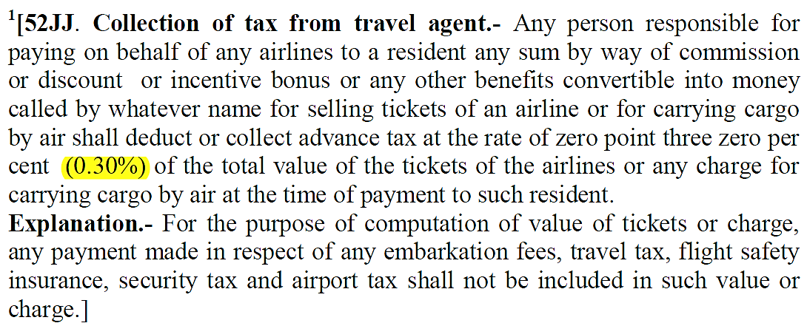
Legal Foundations – Tax Rate
Tax Bracket: 35%
Private Limited Company
Ordinance: Income Tax Ordinance 1984
Source: National Board of Revenue. (2019, October 22). NBR Publications. Retrieved from National Board of Revenue, Bangladesh: http://nbr.gov.bd/publications/all-publication/en

Slide 57
Legal Foundations – Acts List
Acts | Year
Proposed Tourism Act | 2012
National Tourism Policy | 2010
Information & Communication Technology Act | 2013
National Information & Communication Technology Policy | 2018
Digital Security Act | 2018
Tourist Resort Act | 2010
Bangladesh Tourism Protected Area and Exclusive Tourist Zone Act | 2010
Bangladesh Tourism Board Act | 2010
Bangladesh Travel Agencies (Registration & Control) Act | 2013
Source: Finance, M. o. (2019, October 22). Policies, Acts and Laws. Retrieved from Economic Relations Division (ERD): https://erd.gov.bd/site/page/Govt--Policies,-Acts-and-Laws
Source: Mubina, K., & Anis, A. (2017, June 16). Bangladesh as an Ecotourism Destination. Retrieved from Researchgate: https://www.researchgate.net/figure/Present-Scenario-of-Tourism-Related-Laws-and-Acts-in-Bangladesh_

Slide 58
Legal Foundations – Institutions
Bangladesh Parjatan Corporation (BPC)
National Hotel &
Tourism Training Institute
Bangladesh Tourism Board
Under The Ministry Of Civil Aviation And Tourism Established In 1972
Institute For Professional Tourism Management Training
Established In 2010 To Meet The Strong Demand For Private Sector And The Tourism Professionals
Source: Ahmad, S. (2017, March 26). Tourism Industry in Bangladesh. Retrieved from The Daily Star

Slide 59
Legal Foundations – Global
Acts | Year | Described
Tourism Act | 1969 | Focuses On The Tourism Organizations And Their Coordination
Transport Act | 1985 | Controls And Regulates National & Private Bus Transport Companies
Package Travel & Tour Regulations | 1992 | Controls Delivering Of Responsibilities Of Tour Operators To Their Customers
Surface Law | 1979 | Governed By “The International Carriage Of Passenger By Road Act”
Sea Law | 1974 | Governed By “The Athens Convention”
Air Law | 1944 | Defined By “The Warsaw Convention”
Tourism laws are also affected by “Health and Safety Commission”, “International Air Transport Association”, “Strategic Rail Authority”, “Civil Aviation Authority”
Source: UNTWO. (2019, October 22). Tourism Legislation and Regulation. Retrieved from UNTWO World Tourism Organization: http://www2.unwto.org/tourism-legislation-and-regulation

Slide 60
Risk
Analysis

Slide 61
Legal Foundations – Institutions
Risk Name | Description | Mitigation Strategy
Demand Overestimation Risk | The risk that originates from overestimating the demand of our service in the market. | It can be mitigated by continuous analysis of the market and intensive marketing
Extortion Risk | Getting harassed by local goons and parties for money or other demands could lead to this risk. | It is something that can’t be solved but currently with increasing effort of law enforcement it is decreasing.
Risk of Lawsuits | There is always the risk of being sued by customers when not being able to provide the promised services. | It will be mitigated with an effort to providing superior service.
Risk of the Tourist Spots’ Environmental Hazard | Tourist spots get so littered because of our lack of care for the environment or even get wiped out because of environmental hazard. It | It will be mitigated by our awareness program targeted to reduction of plastic usage in tourist spot.

Slide 62
Thank You!

